Slide 1

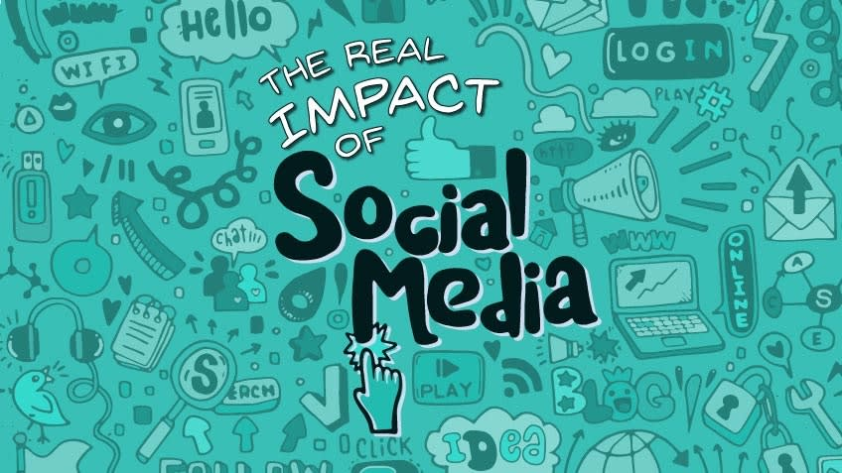

Slide 2

What is social media?
Social media is the act of interaction among people in which they exchange information by participating in social networking.

Slide 3
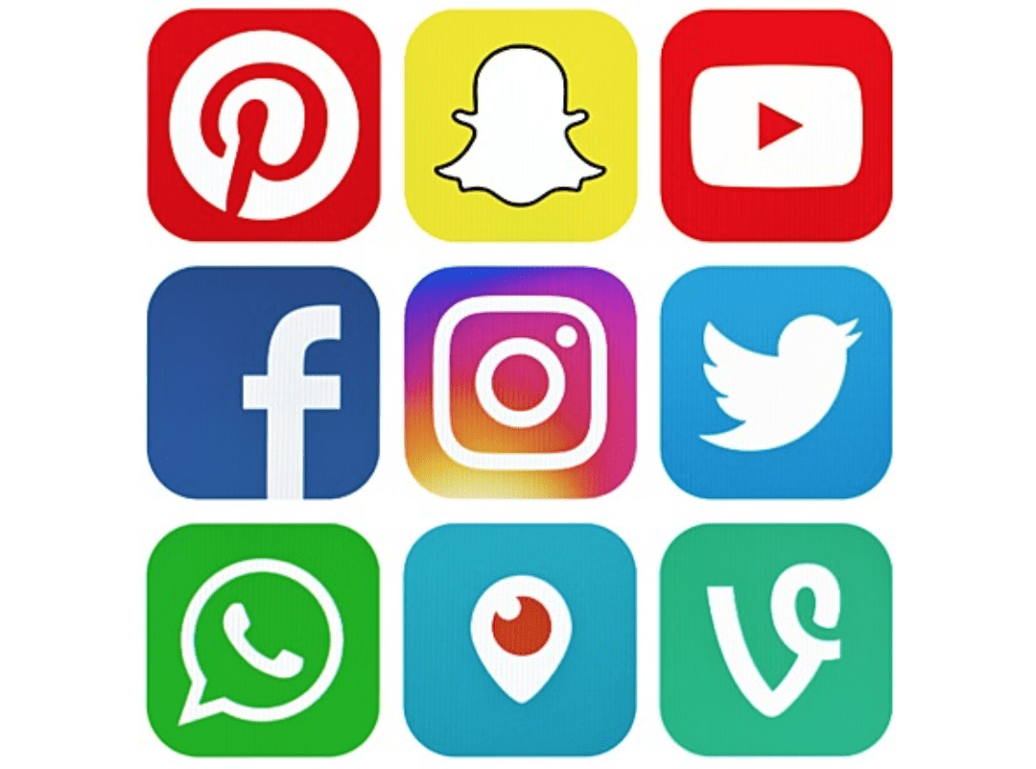
Popular social media
Whatsapp
Facebook
Twitter
YouTube
Google
Palm chart

Slide 4
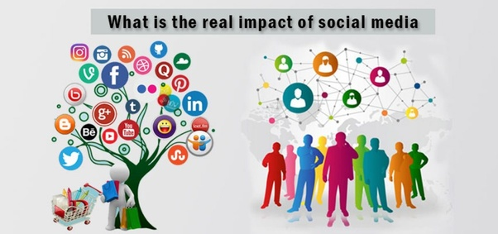
Positive effects of social media

Slide 5

Positive effect on youth and communication
It creates relationship
Helps when seeking for a job
It offers opportunity for writers
Helps in communication
Acts as a media of advert
Save money

Slide 6
Positive effects on society and students
Helps in making friend
Helps in uniting people
It enables community participation
Helps in online learning
Helps in getting class information
It enhances online tutorials

Slide 7
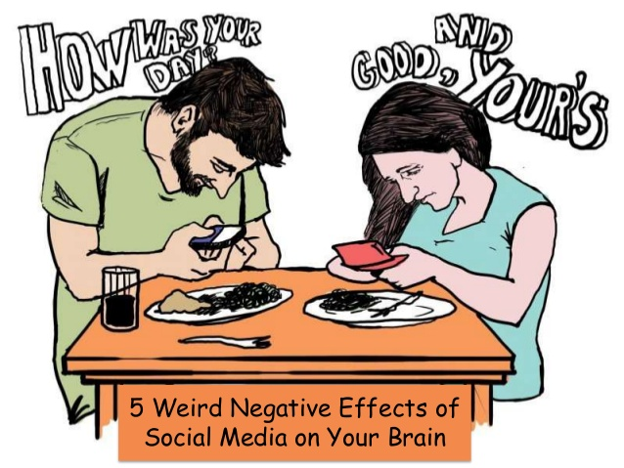
Negative effects of social media

Slide 8
Negative effects on communication and society
Time consuming
Misunderstanding of information
Leads to cyber-bullying
It is costly
Leads to comparison with one another
Emergency of privacy

Slide 9
Negative effects on youths and health
Leads to poor performance
Outbreak of drugs and alcohol
Impairs judgment
Affects mental and physical health
Leads to addiction
Discouragement from physical body exercise

Slide 10
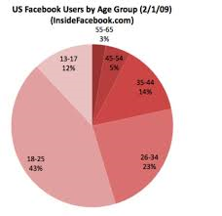

Slide 11
Link of a video
https://www.youtube.com/watch?v=-vREhypQ51s&t=58s

